Slide 1
Programming 4
14.1 Intro to Ruby
Semester 2, 2019

Slide 2
About Ruby
First introduced in December 1995 by Yukihiro Matsumoto
Dynamic, interpreted, OO language
Lisp at its core
Object system like that of Smalltalk
Blocks inspired by higher-order functions
Practical utility like that of Perl
Influence by Lisp, Smalltalk, Perl, Python, Eiffel, etc
The name “Ruby” originated during an online chat session between Matsumoto and Keiju Ishitsuka
Notes:
- Everything is an object and all of those objects can be overridden.

Slide 3
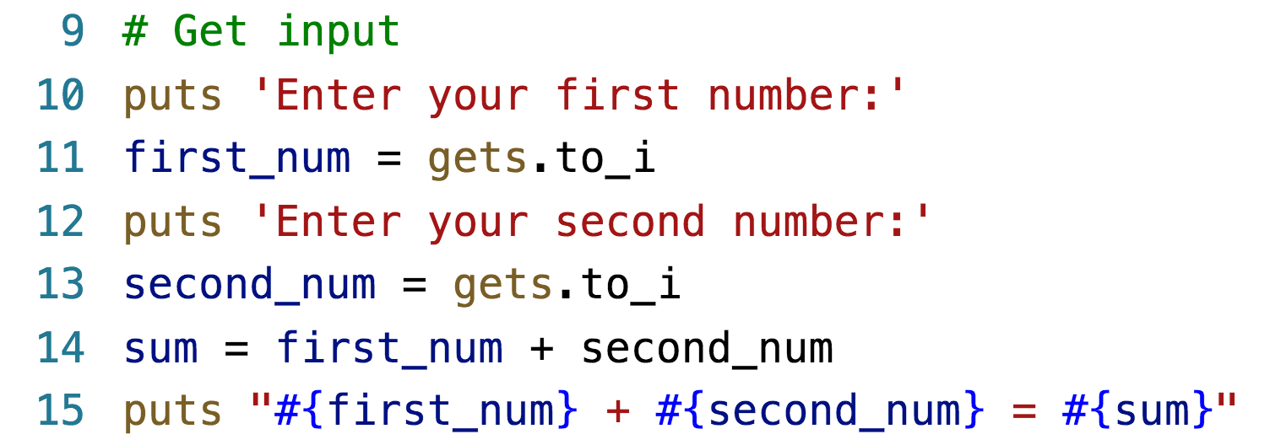
Syntax – get input

Slide 4
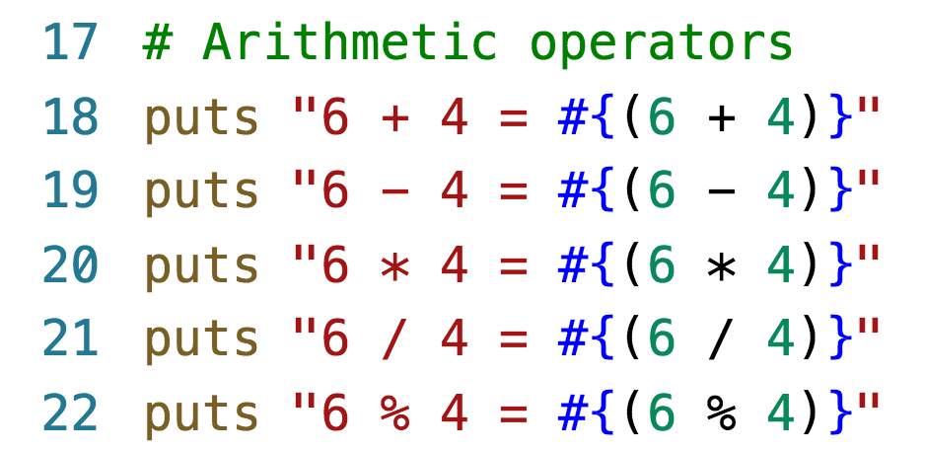
Syntax – arithmetic operators

Slide 5
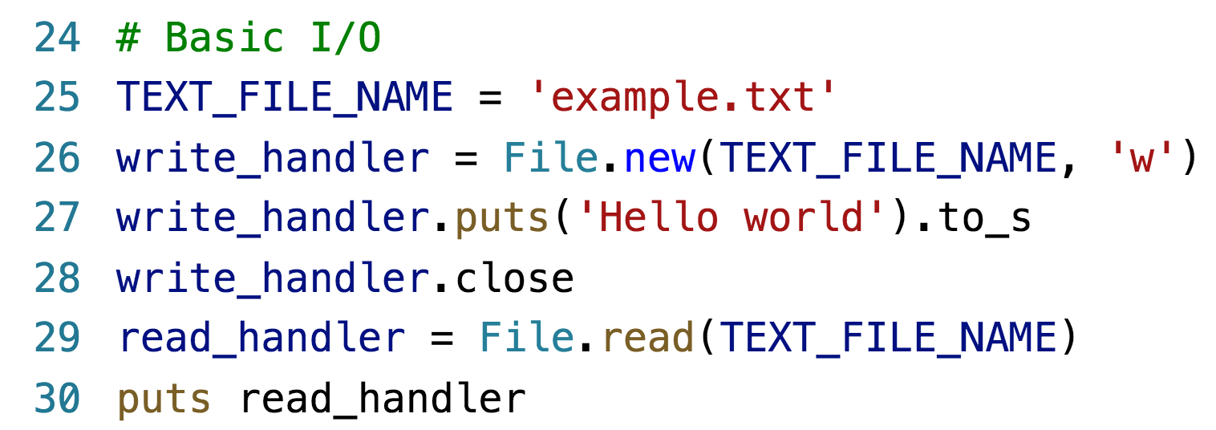
Syntax – basic i/o

Slide 6
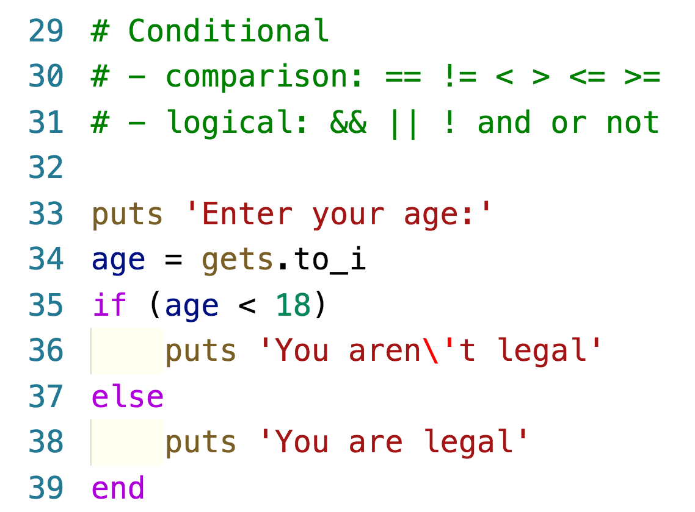
Syntax – conditional

Slide 7
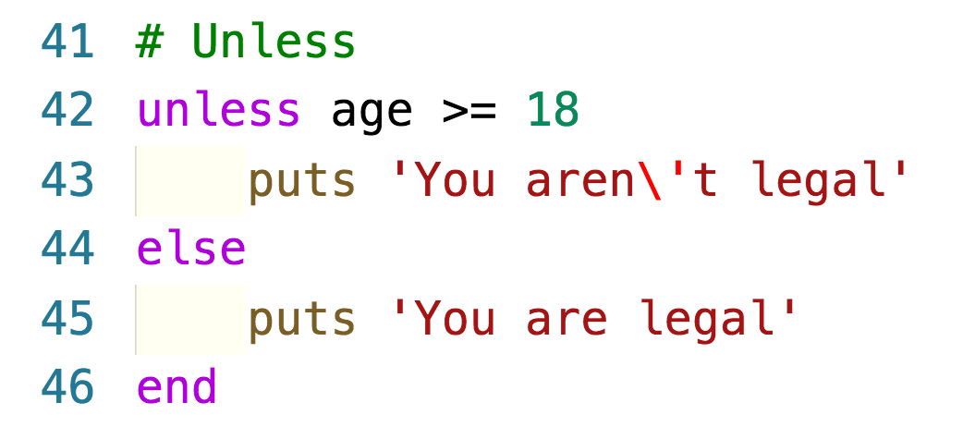
Syntax – unless

Slide 8
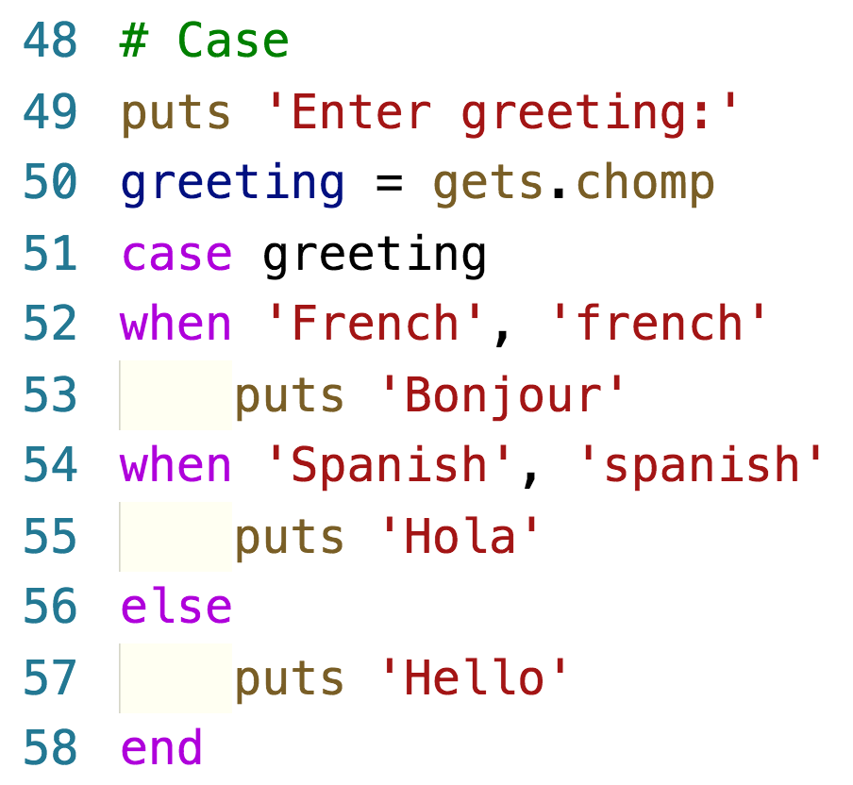
Syntax – case

Slide 9
Syntax – ternary
(condition) ? return if true : return if false
Alternative to if/else statements

Slide 10
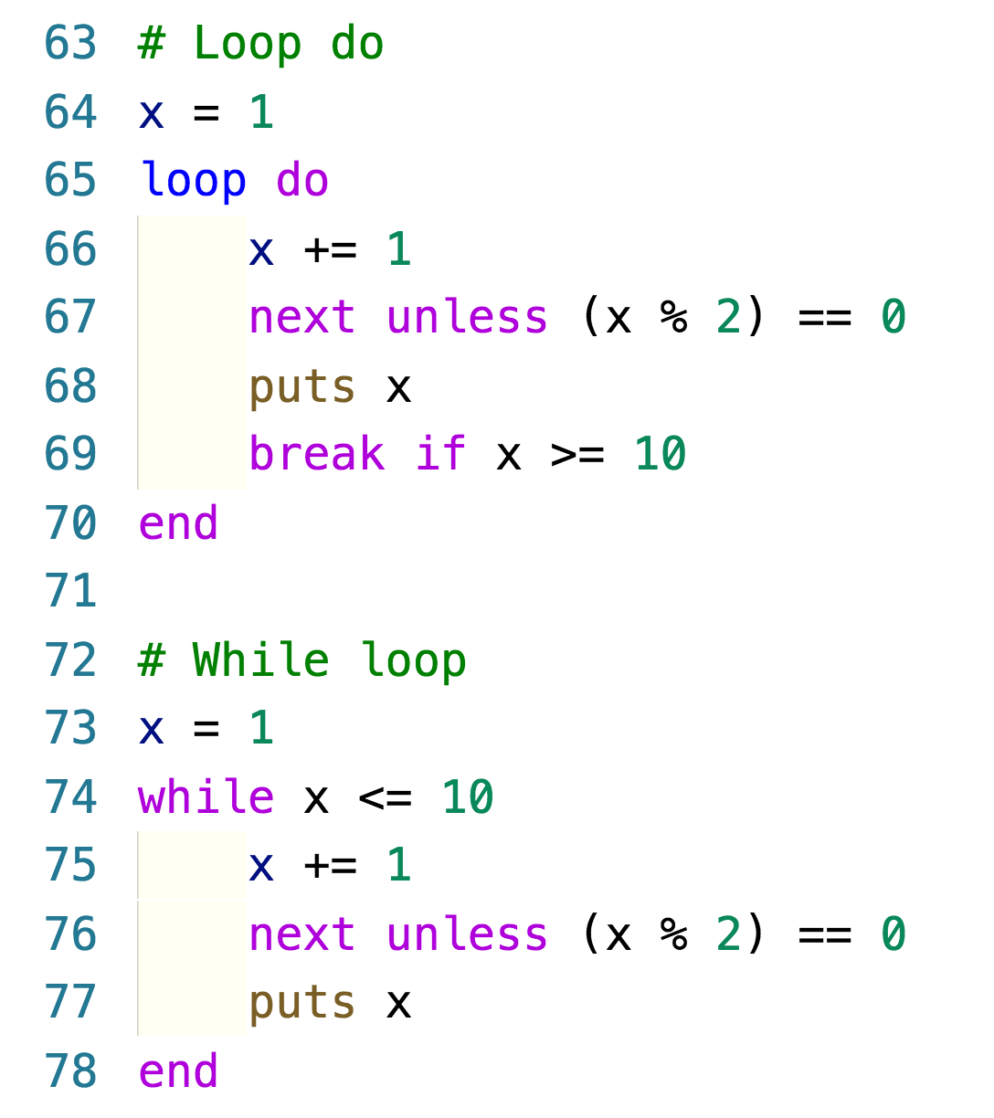
Syntax – loop do and while loop

Slide 11
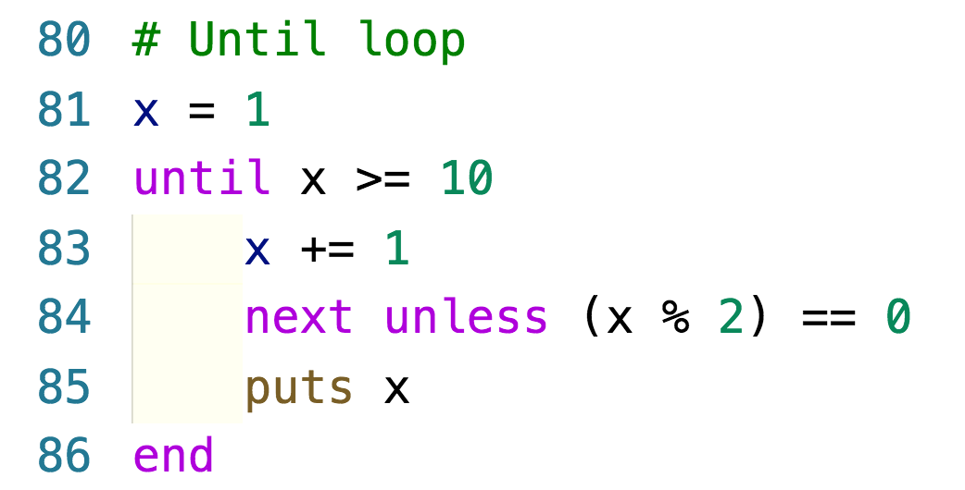
Syntax – until loop

Slide 12
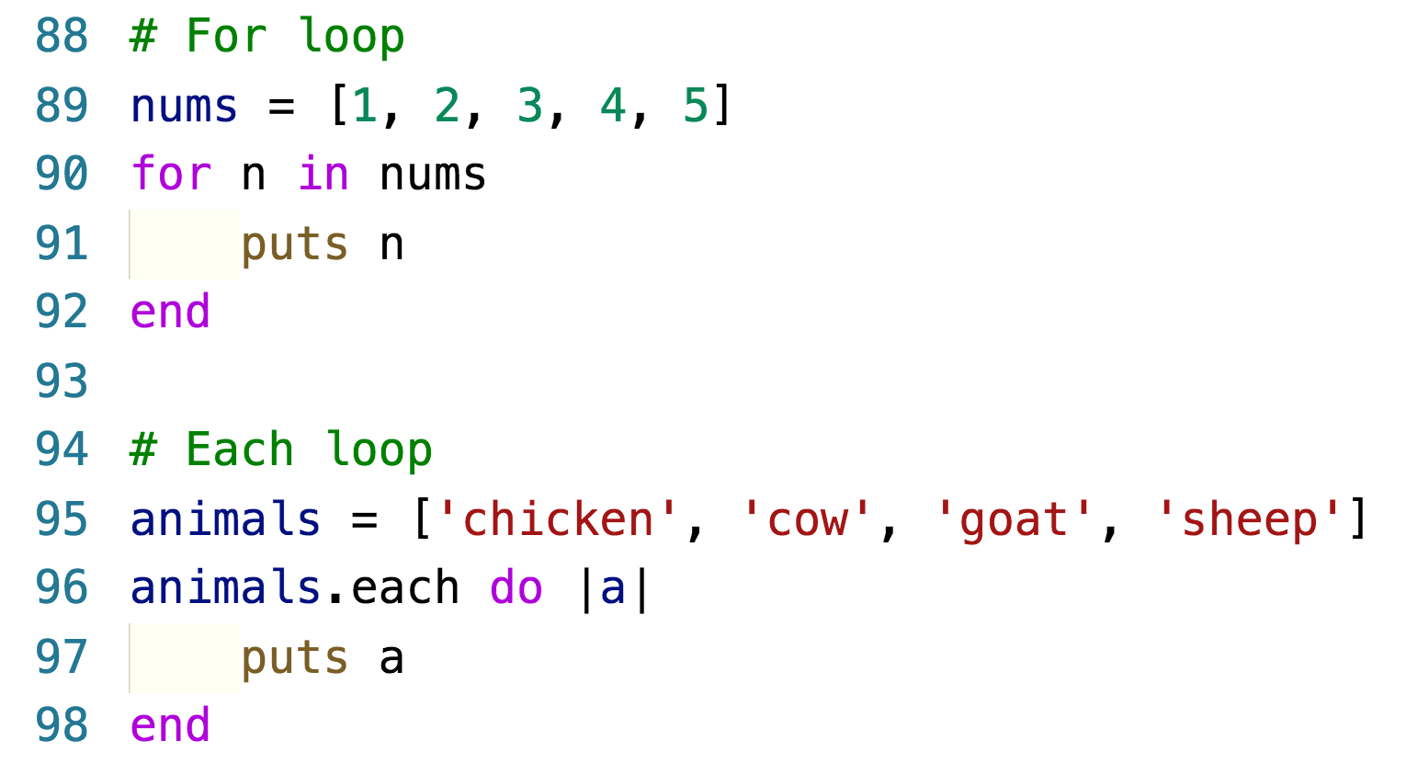
Syntax – for loop and each loop

Slide 13
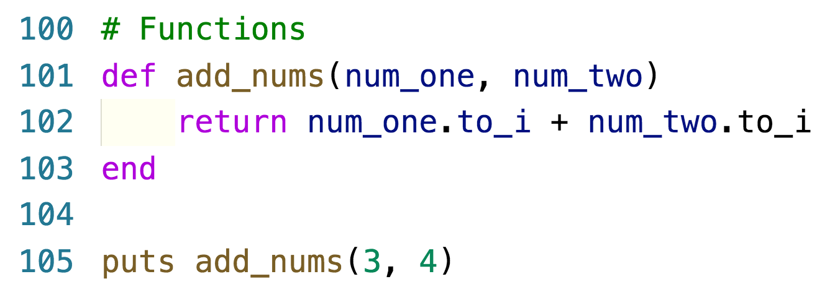
Syntax – functions

Slide 14
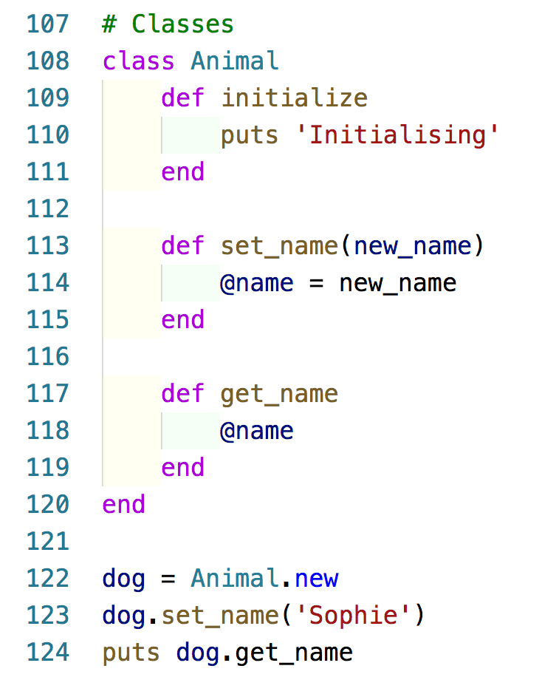
Syntax – classes

Slide 15
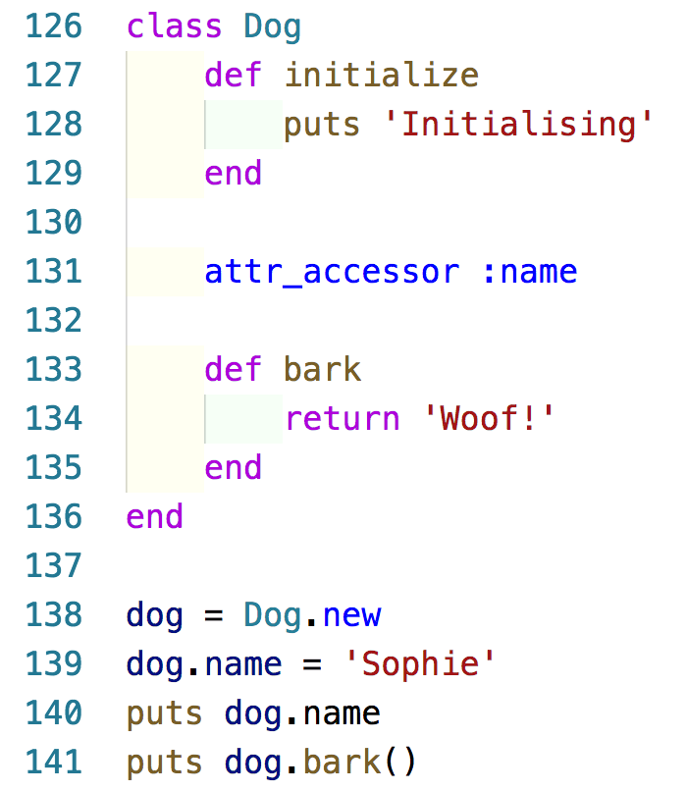
Syntax – classes

Slide 16
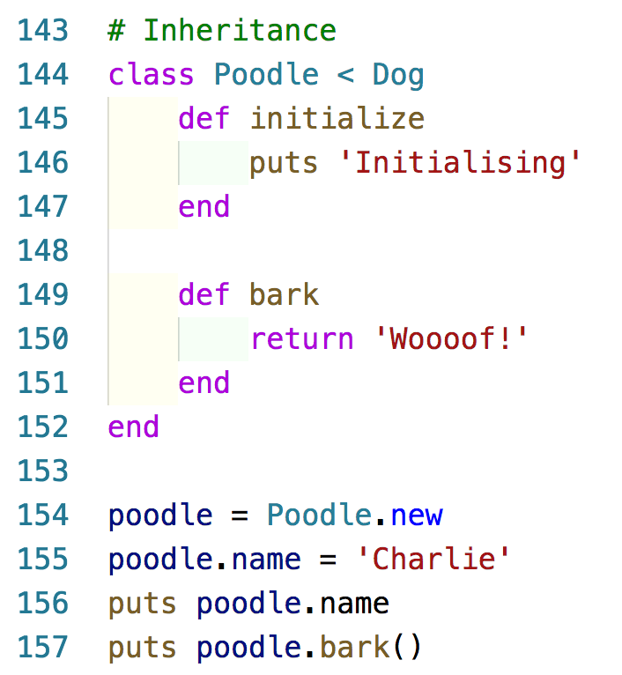
Syntax – inheritance

Slide 17
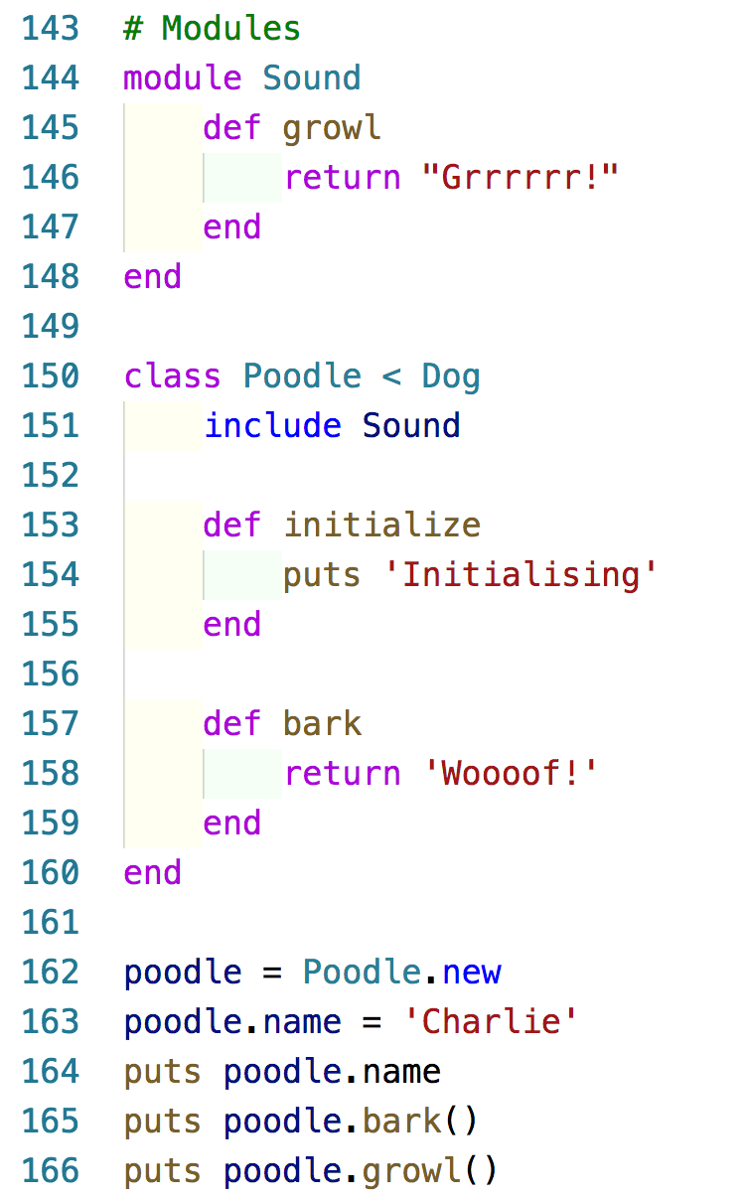
Syntax – modules

Slide 18
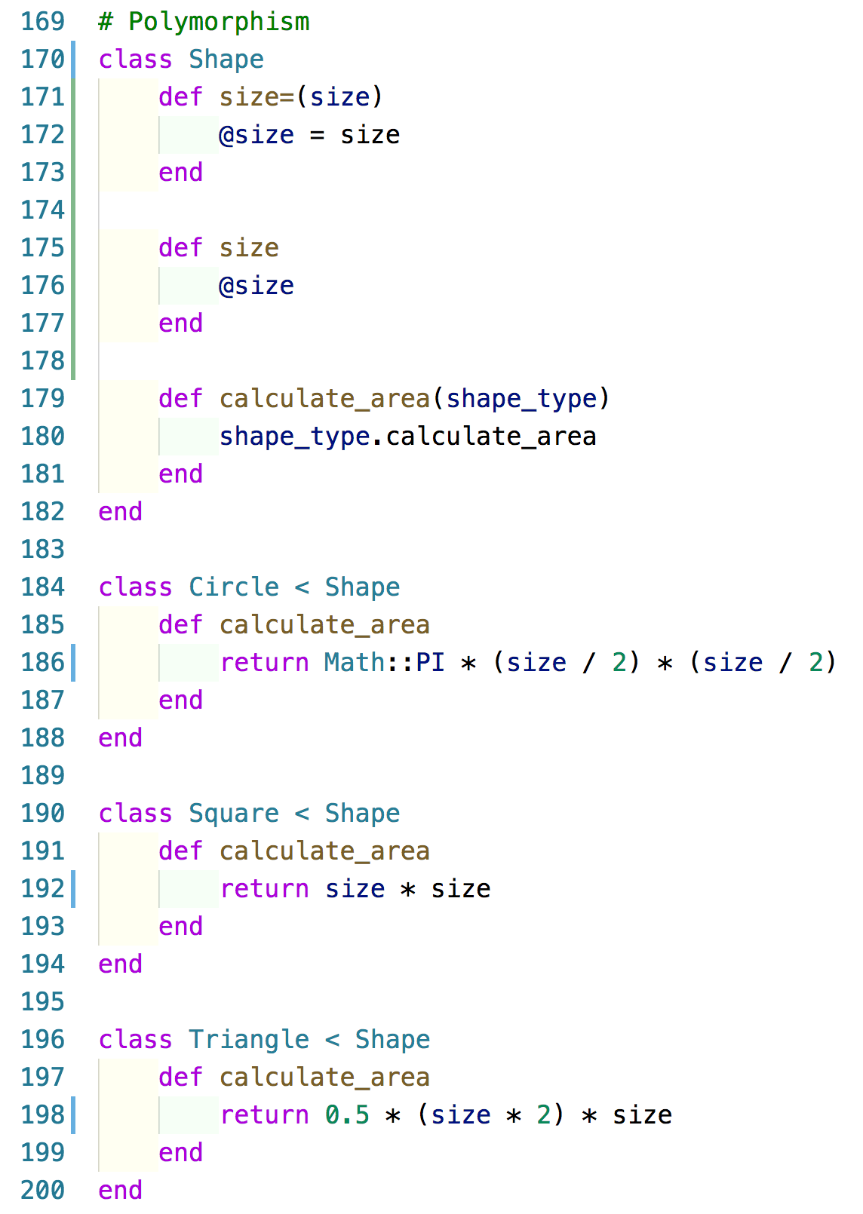
Syntax – polymorphism

Slide 19
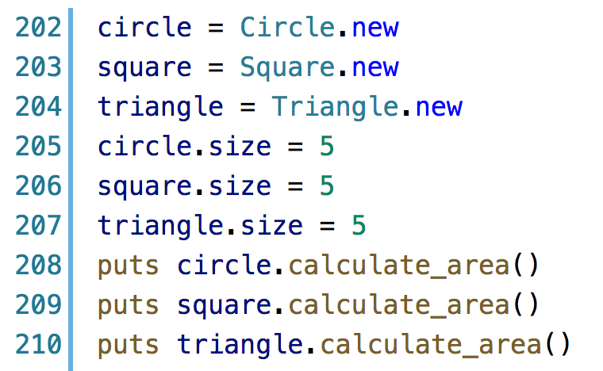
Syntax – polymorphism

